Slide 1


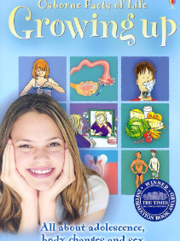
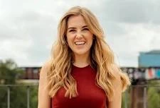



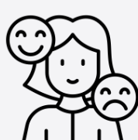

Unit 2: Roman Britain
Year group: Reception Term: Summer 2 Topic: Changing Me
Relationships and Health Guidance |  | Substantive Knowledge | Substantive Knowledge |  | Vocabulary | Vocabulary
By the end of primary school pupils should know: what sorts of boundaries are appropriate in friendships with peers and others (including in a digital context). about the concept of privacy and the implications of it for both children and adults; including that it is not always right to keep secrets if they relate to being safe. that each person’s body belongs to them, and the differences between appropriate and inappropriate or unsafe physical, and other, contact. how to respond safely and appropriately to adults they may encounter (in all contexts, including online) whom they do not know. how to recognise and report feelings of being unsafe or feeling bad about any adult. how to ask for advice or help for themselves or others, and to keep trying until they are heard. how to report concerns or abuse, and the vocabulary and confidence needed to do so. where to get advice e.g. family, school and/or other sources. |  | I can identify similarities between people in my class. I can tell you what bullying is. I know some people who I could talk to if I was feeling unhappy or being bullied. I know how to make new friends. I can tell you some ways I am different from my friends. | Know the names and functions of some parts of the body (see vocabulary list). Know that we grow from baby to adult. Know who to talk to if they are feeling worried. Know that sharing how they feel can help solve a worry. Know that remembering happy times can help us move on. |  | Eye, Foot, Eyebrow, Forehead, Ear, Mouth, Arm, Leg, Chest, Knee, Nose, Tongue, Finger, Toe, Stomach, Hand, Baby, Grown-up, Adult, Change, Worry, Excited, Memories, Healthy, Grow. | Similarity/similar Same as Different from Difference Similarity Bullying Bullying behaviour Courage Deliberate On purpose
 |  |  |  |  | Key People |  | High quality texts
 |  |  |  |  | Maddie Moate Madeleine Moate is a British television presenter, podcaster, YouTuber and children's author best known for presenting the CBeebies series Maddie's Do You Know, inspiring curiosity and questioning in children. |  | Usborne book about Growing Up
Prior Learning
Preschool – Resilient children are more likely to take healthy risks because they don’t fear falling short of expectations. They are curious, brave and trusting of their own instincts. They learn to know their limits and push themselves to step outside of their comfort zone. This helps them to reach their long-term goals and helps them solve their problems independently.
Prior Learning |  |  |  |  | Disciplinary Knowledge | Disciplinary Knowledge
Future Learning |  |  |  |  | Can identify how they have changed from a baby. Can say what might change for them as they get older. Recognise that changing class can elicit happy and/or sad emotions. Can say how they feel about changing class/ growing up. Can identify positive memories from the past year in school/ home. | I can tell you some ways in which I am the same as my friends. I can tell you some ways I am different from my friends. I understand how being bullied might feel. I can be kind to children who are bullied. I know how it feels to make a new friend. I understand these differences make us all special and unique.
Year 1 – Know that animals including humans have a life cycle. Know that changes happen when we grow up. Know that people grow up at different rates and that is normal. Know the names of male and female private body parts. Know that there are correct names for private body parts and nicknames, and when to use them. Know which parts of the body are private and that they belong to that person and that nobody has the right to hurt these. Know who to ask for help if they are worried or frightened. Know that learning brings about change.
Teaching Ideas
Week One | Week Two | Week Three |  | Week Four |  | Week Five |  | Week Six
My Body | Respecting my body | Growing up |  | Fun and Fears |  | Fun and Fears |  | Celebration
Big Finish: Memory Box

