Slide 1


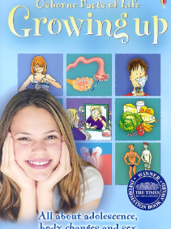
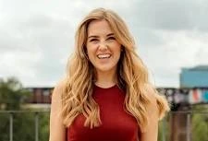


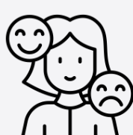



Unit 2: Roman Britain
Year group: 2 Term: Summer 2 Topic: Changing Me
Relationships and Health Guidance |  | Substantive Knowledge | Substantive Knowledge |  | Vocabulary | Vocabulary
By the end of primary school pupils should know: what sorts of boundaries are appropriate in friendships with peers and others (including in a digital context). about the concept of privacy and the implications of it for both children and adults; including that it is not always right to keep secrets if they relate to being safe. that each person’s body belongs to them, and the differences between appropriate and inappropriate or unsafe physical, and other, contact. how to respond safely and appropriately to adults they may encounter (in all contexts, including online) whom they do not know. how to recognise and report feelings of being unsafe or feeling bad about any adult. how to ask for advice or help for themselves or others, and to keep trying until they are heard. how to report concerns or abuse, and the vocabulary and confidence needed to do so. where to get advice e.g. family, school and/or other sources. |  | I can identify similarities between people in my class. I can tell you what bullying is. I know some people who I could talk to if I was feeling unhappy or being bullied. I know how to make new friends. I can tell you some ways I am different from my friends. | Know that life cycles exist in nature. Know that aging is a natural process including old-age. Know that some changes are out of an individual’s control. Know how their bodies have changed from when they were a baby and that they will continue to change as they age. Know the physical differences between male and female bodies. Know the correct names for private body parts. Know that private body parts are special and that no one has the right to hurt these. Know who to ask for help if they are worried or frightened. Know there are different types of touch and that some are acceptable and some are unacceptable. |  | Control, Life cycle, Adult, Fully grown, Old, Young, Respect, Appearance, Physical, Toddler, Child, Teenager, Independent, Freedom, Responsibilities, Male, Female, Vagina, Penis, Testicles, Vulva, Anus, Public, Private, Touch, Texture, Like, Dislike, Acceptable, Unacceptable, Comfortable, Uncomfortable, Excited, Nervous, Anxious, Happy. | Similarity/similar Same as Different from Difference Similarity Bullying Bullying behaviour Courage Deliberate On purpose
 |  |  |  |  | Key People |  | High quality texts
 |  |  |  |  | Maddie Moate Madeleine Moate is a British television presenter, podcaster, YouTuber and children's author best known for presenting the CBeebies series Maddie's Do You Know, inspiring curiosity and questioning in children. |  | Usborne book about Growing Up
Prior Learning
Year 1 – Know that animals including humans have a life cycle. Know that changes happen when we grow up. Know that people grow up at different rates and that is normal. Know the names of male and female private body parts. Know that there are correct names for private body parts and nicknames, and when to use them. Know which parts of the body are private and that they belong to that person and that nobody has the right to hurt these. Know who to ask for help if they are worried or frightened. Know that learning brings about change.
Prior Learning |  |  |  |  | Disciplinary Knowledge | Disciplinary Knowledge
 |  |  |  |  | Can appreciate that changes will happen and that some can be controlled and others not. Be able to express how they feel about changes. Show appreciation for people who are older. Can recognise the independence and responsibilities they have now compared to being a baby or toddler. Can say who they would go to for help if worried or scared. Can say what types of touch they find comfortable/ uncomfortable. Be able to confidently ask someone to stop if they are being hurt or frightened. Can say what they are looking forward to in the next year. Can say what greater responsibilities and freedoms they may have in the future.
Future Learning |  |  |  |  |  | I can tell you some ways in which I am the same as my friends. I can tell you some ways I am different from my friends. I understand how being bullied might feel. I can be kind to children who are bullied. I know how it feels to make a new friend. I understand these differences make us all special and unique.
Year 3 – I understand how babies grow and develop in the Mother’s uterus I understand what a baby needs to live and grow. I understand that in animals and humans lots of changes happen between conception and growing up, and that usually it is the female who has the baby.
Teaching Ideas
Week One | Week Two | Week Three |  | Week Four |  | Week Five |  | Week Six
Life Cycles in Nature | Growing from young to old | The Changing me |  | Boys and girls bodies |  | Assertiveness |  | Looking Ahead
Big Finish: Wishes for year 3

