Slide 1


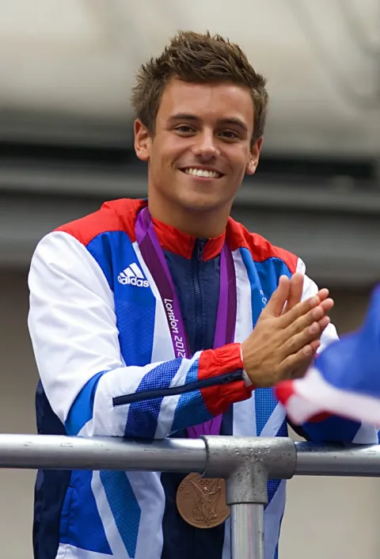

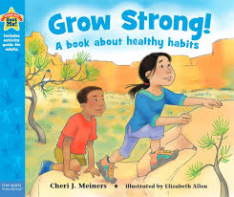






Unit 2: Roman Britain
Year group: Reception Term: Spring 2 Topic: Healthy Me
Key Objectives |  | Substantive Knowledge | Substantive Knowledge |  | Vocabulary | Vocabulary
By the end of primary school, pupils should know: the characteristics of good physical health and mental wellbeing. Teachers should be clear that mental wellbeing is a normal part of daily life, in the same way as physical health. This starts with pupils being taught about the benefits and importance of daily exercise, good nutrition and sufficient sleep, and giving pupils the language and knowledge to understand the normal range of emotions that everyone experiences. This should enable pupils to articulate how they are feeling, develop the language to talk about their bodies, health and emotions and judge whether what they are feeling and how they are behaving is appropriate and proportionate for the situations that they experience. |  | I can identify similarities between people in my class. I can tell you what bullying is. I know some people who I could talk to if I was feeling unhappy or being bullied. I know how to make new friends. I can tell you some ways I am different from my friends. | Know the names for some parts of their body. Know what the word ‘healthy’ means. Know some things that they need to do to keep healthy. Know that they need to exercise to keep healthy. Know which foods are healthy. Know how to help themselves go to sleep and that sleep is good for them. Know when and how to wash their hands properly. Know what to do if they get lost. Know how to say No to strangers. |  | Healthy, Exercise, Head, Shoulders, Knees, Toes, Sleep, Heart, Active, Wash, Clean, Safe adult, Scared, Trust | Similarity/similar Same as Different from Difference Similarity Bullying Bullying behaviour Courage Deliberate On purpose
Prior Learning |  |  |  |  | Key People |  | High quality texts | High quality texts
 |  |  |  |  | Tom Daly Tom realised that he grew as a person when he was true to himself. He supports causes that find ways to help others grow. He eats healthily and does lots of exercise. |  | Oliver’s Vegetable by Vivian French Grow Strong by Cheryl J Meiners | Oliver’s Vegetable by Vivian French Grow Strong by Cheryl J Meiners
Pre-school – Children know the importance for good health of physical exercise, and a healthy diet, and talk about ways to keep healthy and safe. They manage their own basic hygiene and personal needs successfully, including dressing and going to the toilet independently.
Prior Learning |  |  |  |  | Disciplinary Knowledge | Disciplinary Knowledge
Future Learning |  |  |  |  | Recognise how exercise makes them feel. Can explain what they need to do to stay healthy. Can give examples of healthy food. Can explain how they might feel if they don’t get enough sleep. Can explain what to do if a stranger approaches them. | I can tell you some ways in which I am the same as my friends. I can tell you some ways I am different from my friends. I understand how being bullied might feel. I can be kind to children who are bullied. I know how it feels to make a new friend. I understand these differences make us all special and unique.
Year 1 – Know the difference between being healthy and unhealthy. Know some ways to keep healthy. Know how to make healthy lifestyle choices. Know how to keep themselves clean and healthy. Know that germs cause disease / illness. Know that all household products, including medicines, can be harmful if not used properly. Know that medicines can help them if they feel poorly. Know how to keep safe when crossing the road. Know about people who can keep them safe.
Teaching Ideas
Week One | Week Two | Week Three |  | Week Four |  | Week Five |  | Week Six
Everybody’s Body | We Like to Move it, Move it | Food Glorious Food |  | Sweet Dreams |  | Keeping Clean |  | Safe Adults
Big Finish: Fruit or cooking activity (involving skills of peeling, mixing, pouring)

