Slide 1


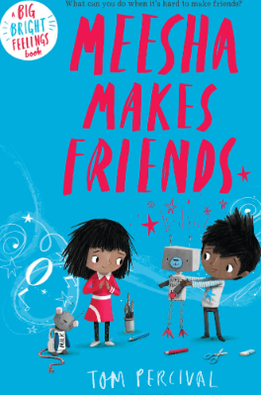
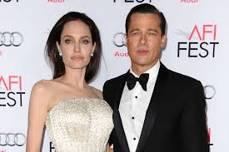

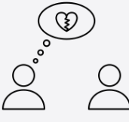

Unit 2: Roman Britain
Year group: Reception Term: Summer 1 Topic: Relationships
Relationships and Health Guidance |  | Substantive Knowledge | Substantive Knowledge |  | Vocabulary | Vocabulary
By the end of primary school pupils should know: that families are important for children growing up because they can give love, security and stability. the characteristics of healthy family life, commitment to each other, including in times of difficulty, protection and care for children and other family members, the importance of spending time together and sharing each other’s lives. that others’ families, either in school or in the wider world, sometimes look different from their family, but that they should respect those differences and know that other children’s families are also characterised by love and care. that stable, caring relationships, which may be of different types, are at the heart of happy families, and are important for children’s security as they grow up. |  | I can identify similarities between people in my class. I can tell you what bullying is. I know some people who I could talk to if I was feeling unhappy or being bullied. I know how to make new friends. I can tell you some ways I am different from my friends. | Know what a family is. Know that different people in a family have different responsibilities (jobs). Know some of the characteristics of healthy and safe friendship. Know that friends sometimes fall out. Know some ways to mend a friendship. Know that unkind words can never be taken back and they can hurt. Know how to use Jigsaw’s Calm Me to help when feeling angry. Know some reasons why others get angry. |  | Family, Jobs, Relationship, Friend, Lonely, Argue, Fall-out, Words, Feelings, Angry, Upset, Calm me, Breathing. | Similarity/similar Same as Different from Difference Similarity Bullying Bullying behaviour Courage Deliberate On purpose
 |  |  |  |  | Key People |  | High quality texts
Prior Learning |  |  |  |  | Brad Pitt and Angelina Jolie Beginning with the adoption of Maddox from an orphanage in Cambodia in 2001, the pair went on to welcome five more kids into the Jolie-Pitt family. |  | Meesha Makes Friends by Tom Percival
Pre-school – Through supported interaction with others, children learn how to make good friendships, co-operate and resolve conflicts peaceably. These attributes provide a secure platform, from which children can achieve at school and in later life.
Future Learning
Year 1 – Know that everyone’s family is different. Know that there are lots of different types of families. Know that families are founded on belonging, love and care. Know how to make a friend. Know the characteristics of healthy and safe friends. Know that physical contact can be used as a greeting. Know about the different people in the school community and how they help. Know who to ask for help in the school community. Know how to praise themselves and others. Know some of their personal qualities. Can say why they appreciate a special relationship. |  |  |  |  | Disciplinary Knowledge | Disciplinary Knowledge
Future Learning |  |  |  |  | Can identify what jobs they do in their family and those carried out by parents/carers and siblings. Can suggest ways to make a friend or help someone who is lonely. Can use different ways to mend a friendship. Can recognise what being angry feels like. Can use Calm Me when angry or upset. | I can tell you some ways in which I am the same as my friends. I can tell you some ways I am different from my friends. I understand how being bullied might feel. I can be kind to children who are bullied. I know how it feels to make a new friend. I understand these differences make us all special and unique.
Teaching Ideas
Week One | Week Two | Week Three |  | Week Four |  | Week Five |  | Week Six
My family and me | Make Friends, Make Friends Never ever break friends | Make Friends, Make Friends Never ever break friends |  | Falling out and bullying |  | Falling out and bullying |  | Being the best friends we can be
Big Finish: Friendship Mittens

